Slide 1
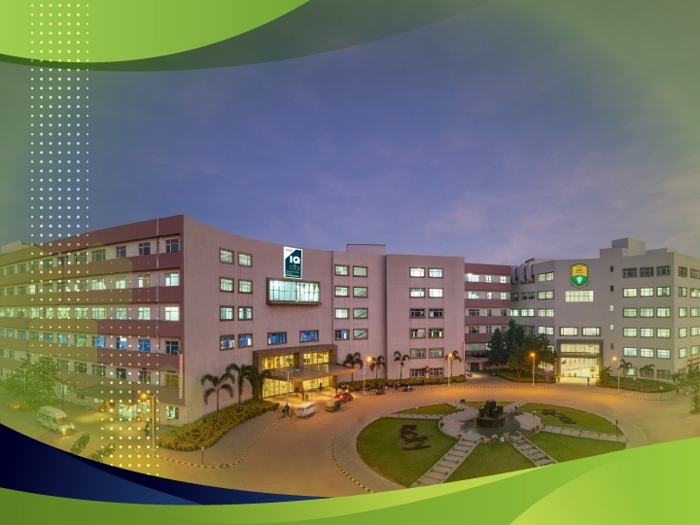

IQ City Medical
College Hospital, Durgapur

Slide 2

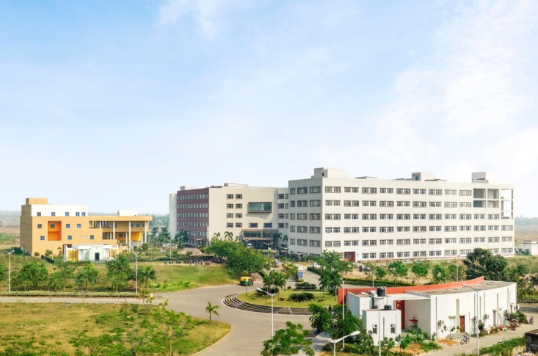
IQ City Medical College Hospital spread over 100 acres, is Eastern India’s largest private teaching hospital. Equipped with state of the art infrastructure, 753 beds, 9 modern OTs, 22 departments and 6 super-specialty departments, IQ City has 350 doctors and specialists round the clock.
IQ City Medical College is ranked among the top private medical colleges of Eastern India. The Medical College has been granted recognition for under graduate and post graduate courses - MBBS and MD (Pre and Para Clinical) respectively by the Medical Council of India. The first batch of the Medical College passed out in the year 2018.

Slide 3
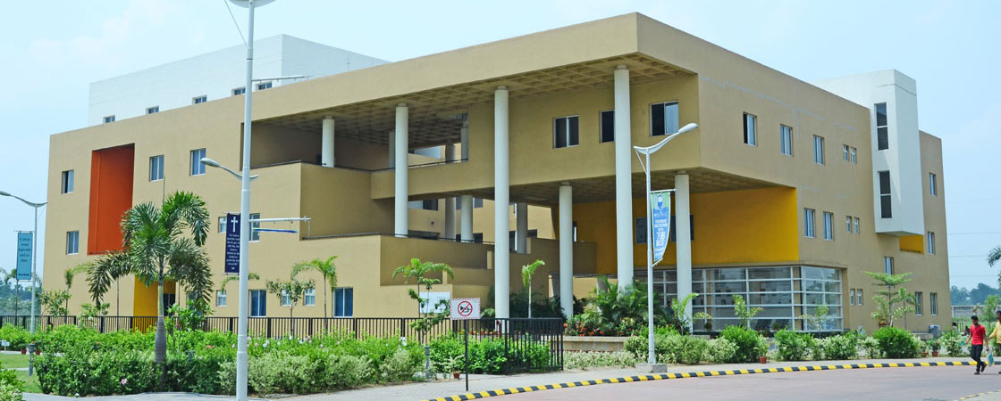
IQ CITY INSTITUTE OF NURSING – DURGAPUR

Slide 4
IQ City Institute of Nursing Sciences admits 100 students for BSC and GNM Nursing courses annually . The Institute is affiliated to the West Bengal University of Health Sciences and recognized by Indian Nursing council and West Bengal Nursing Council. The Institute is equipped with modern Laboratories and spacious class rooms and the students receive practical training in IQ City Hospital which helps in a much better learning experience.

Slide 5
OUR DEPARTMENTS

Slide 6
 | GENERAL MEDICINE |  | RHEUMATOLOGY
 | CARDIOLOGY AND CARDIAC SURGERY |  | NEUROLOGY AND NEURO SURGERY
 | ORTHOPAEDIC AND JOINT REPLACEMENT |  | PSYCHIATRY
 |  |  | PLASTIC SURGERY
 | GENERAL SURGERY |  | RESPIRATORY , SLEEP & CRITICAL CARE MEDICINE
 | GYNAE & OBSTETRICS |  | UROLOGY AND NEPHROLOGY
 | PAEDIATRIC AND PAEDIATRIC SURGERY |  | DERMATOLOGY
 |  |  | DENTISTRY
 | OPHTHALMOLOGY |  | ENT
 | GASTROENTEROLOGY

Slide 7
OUR SERVICES

Slide 8
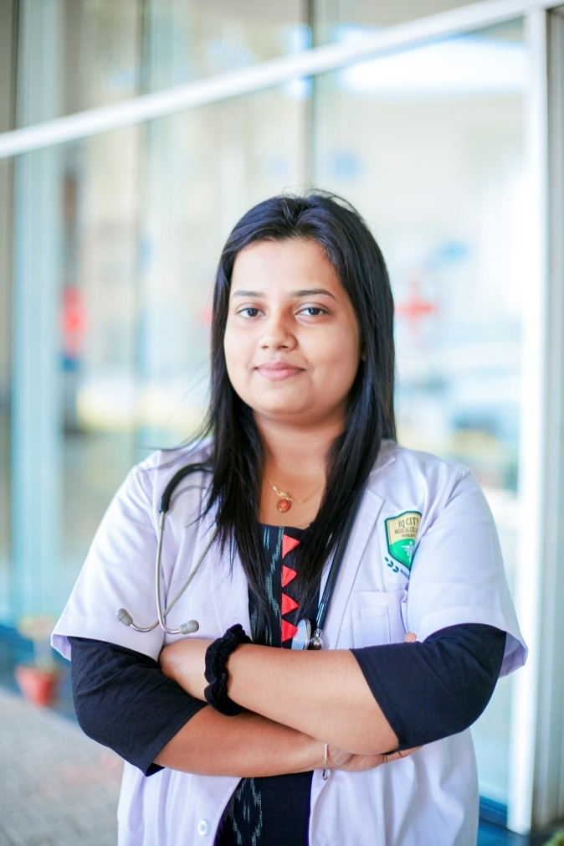
Ambulance
Blood Bank
Cath Lab
Dialysis
Emergency
Laboratory
Pharmacy
Radiology
Critical Care & Burn Unit
Cafeteria

Slide 9
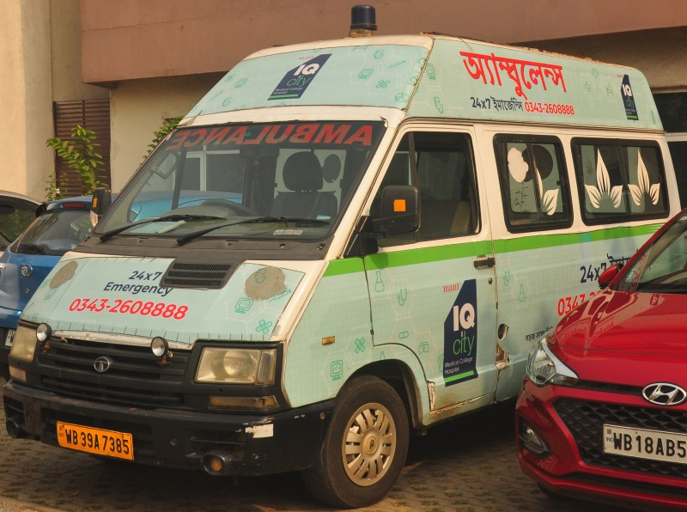
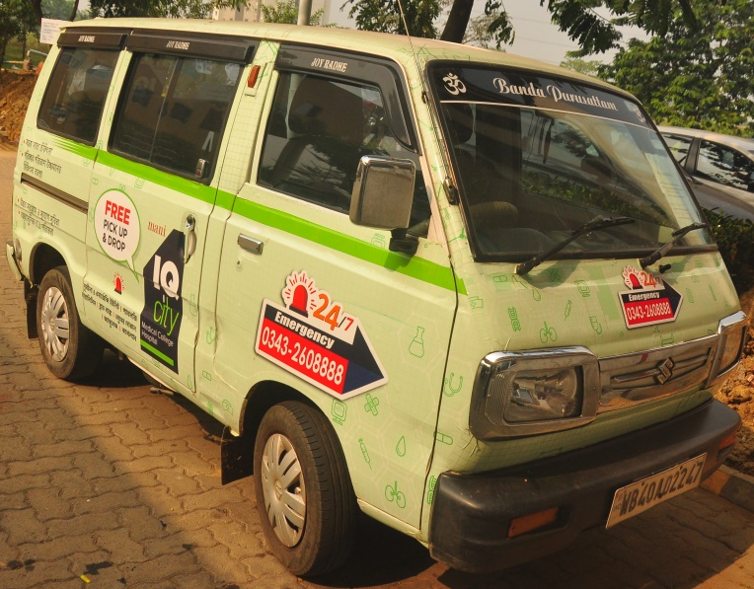
We have got Ambulance services which helps to transport critical patients from various locations of Durgapur and its adjoining areas.
Ambulance:
The Patient pick up vans are also available to bring OPD patients from various locations of Durgapur.

Slide 10
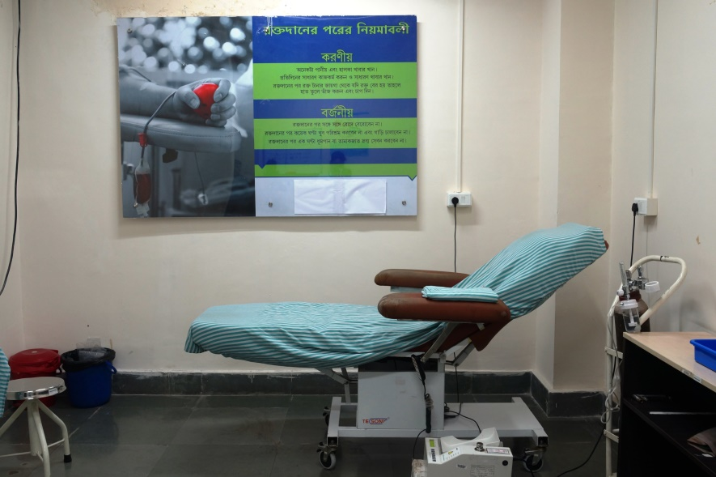
Our Blood Bank and Transfusions services are committed to provide highest quality and safe blood and components at affordable cost to the patients.
Blood Bank:
The blood bank is operational 24×7 throughout the the year and supplies whole blood as well as other forms of blood components

Slide 11
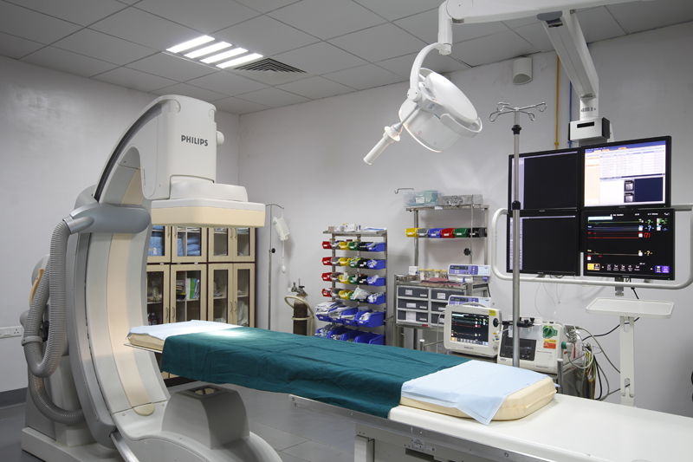
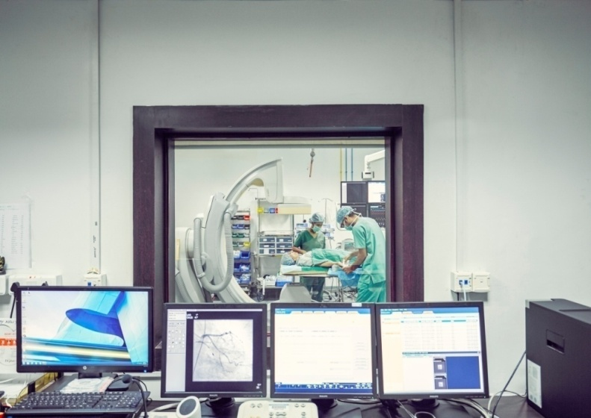
Cath Lab:
Model Name: Philips Allura Centron
Our Allura Centron is a robust interventional Cath lab made to handle a variety of procedures at an excellent pace. Designed for cardiac and EP, ready for the demands of Neuro and Vascular procedures.

Slide 12
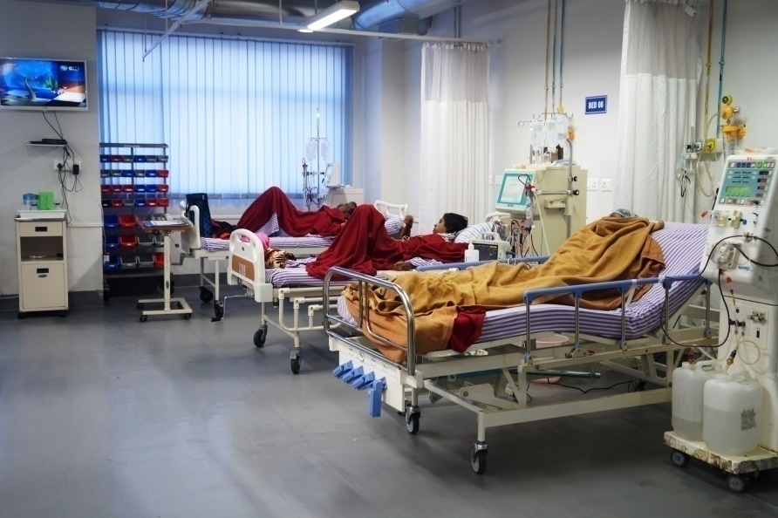
Dialysis:
IQ City Medical College Hospital, Durgapur is equipped with state–of-the-art dialysis units with modern equipment and treatment facilities , work 24/7 to full capacity.
Different services offered by the department include Continuous Renal Replacement Therapy (CRRT), Peritoneal Dialysis (CPD), Plasma Dialysis (Plasmapharesis), Liver Dialysis (MARS Therapy).

Slide 13
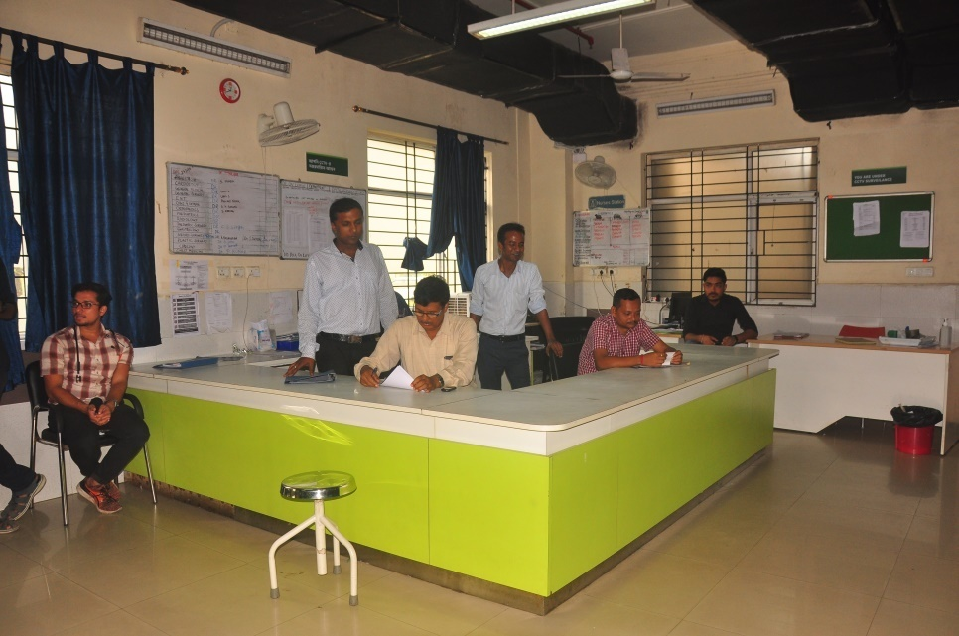
Emergency:
Our 24*7, 25 Bedded Department of Emergency Medicine at IQ City Medical College Hospital is the place to come for care and consultation for most common emergencies and make appropriate recommendations.
Our doctors are trained and experienced emergency physicians. We have in-house specialists, mainly Physician, Surgeon, Orthopaedics, Paediatrician and Gynaecologist .

Slide 14
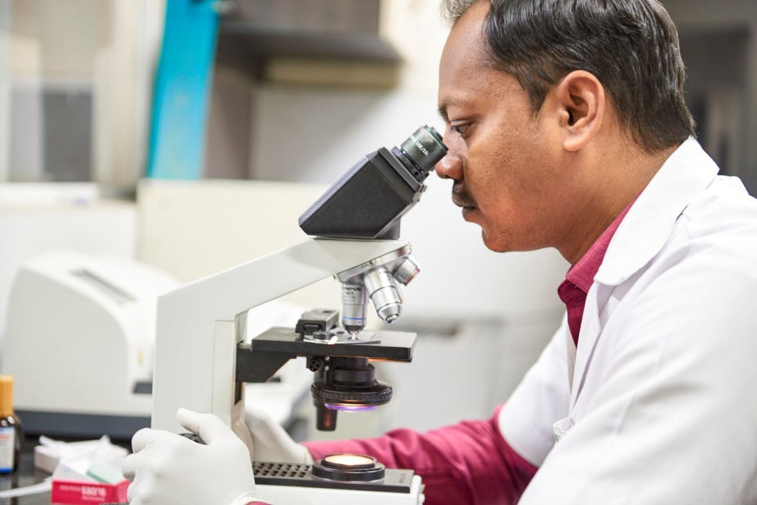
Our Laboratory has a state-of-the-art infrastructure for comprehensive diagnosis and highest quality of clinical care for our patients. The laboratory is manned by dedicated staff who are committed to patient service and care in every possible way.
Laboratory:
Haematology Lab
Histopathology & Cytology Lab
Biochemistry Lab
Microbiology Lab

Slide 15
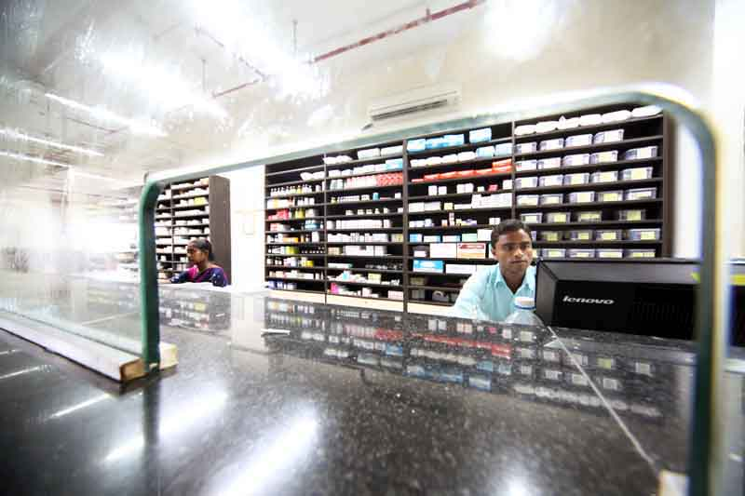
Pharmacy:
Because patient’s health is our priority, our pharmacy remains open for 24×7, with trained pharmacists, and under pharmacovigilance committee,
Other than pharmaceutical products, surgical disposable, general health care products, nutritional supplements are also available.

Slide 16
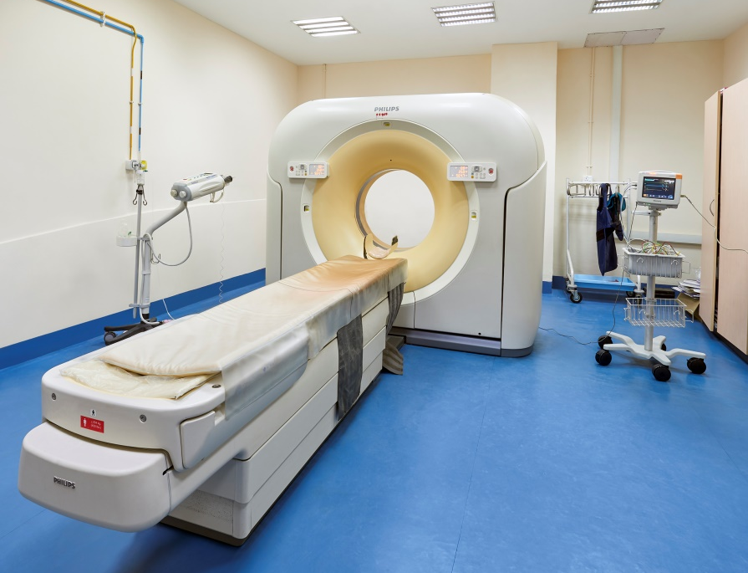
IQ City Medical College Hospital, Durgapur houses a well-equipped Radiology Department with round the clock service.
Radiology:
A variety of imaging techniques such as X-ray , ultrasound, computed tomography (CT), MRI Interventional Radiology are used to diagnose and/or treat diseases.

Slide 17
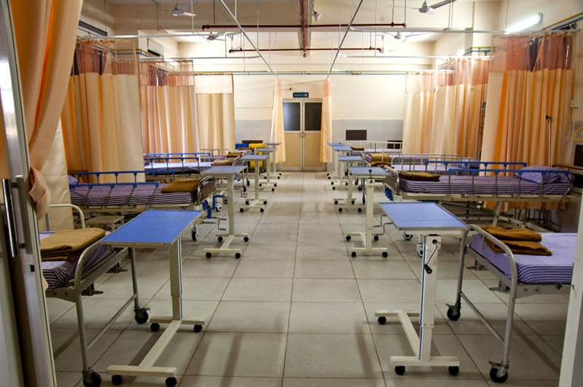
IQ City Medical College hospital is equipped with state of the art Critical care units for all. Our ICUs have a good nurse to patient ratio, supported with upgraded facilities of continuous multi-parameter invasive monitoring, invasive and non invasive mechanical ventilators, infusion pumps, point of care USG and haemodialysis.
Critical Care & Burn Unit:
ICU – 46 bedded Intensive Care Unit (ICU)
CCU – 15 bedded coronary care unit (CCU)
ITU – 04 bedded Intensive Therapy Unit (ITU)
NICU – 10 bedded NICU
PICU – 60 bedded PICU
RICU – 07 bedded RICU
SICU – 10 bedded SICU
Burn Unit – 05 bedded Burn Unit

Slide 18
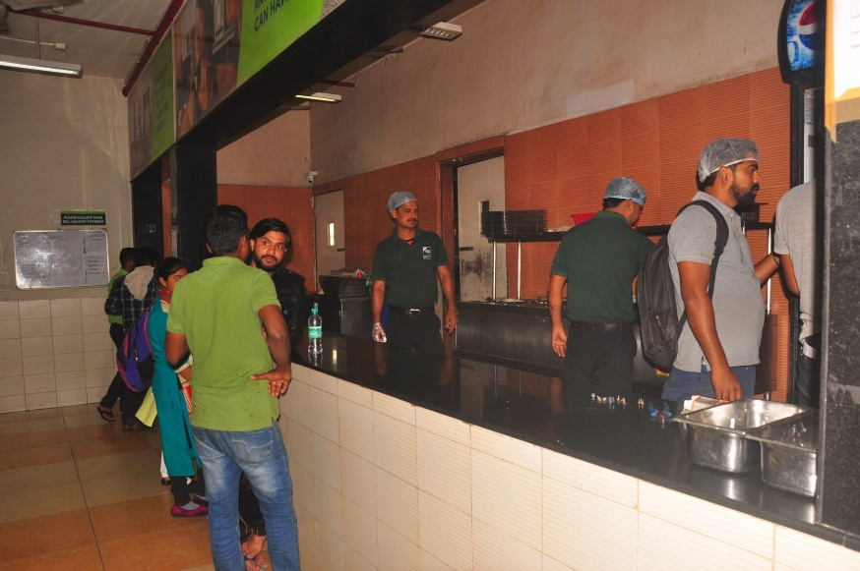
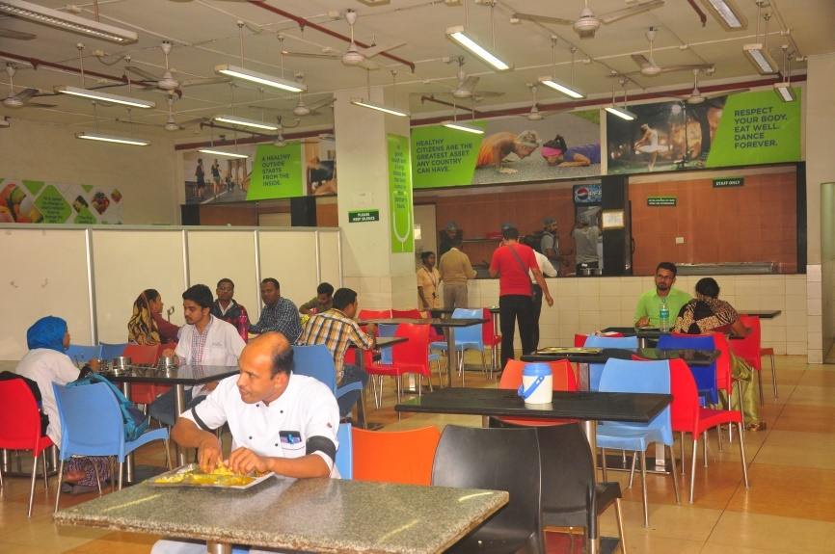
The Hospital has a spacious cafeteria with separate sitting arrangement for Patient Attendants, Doctors , Nurses , Nursing & Medical Students.
Cafeteria:

Slide 19
OUR SCHEMES

Slide 20
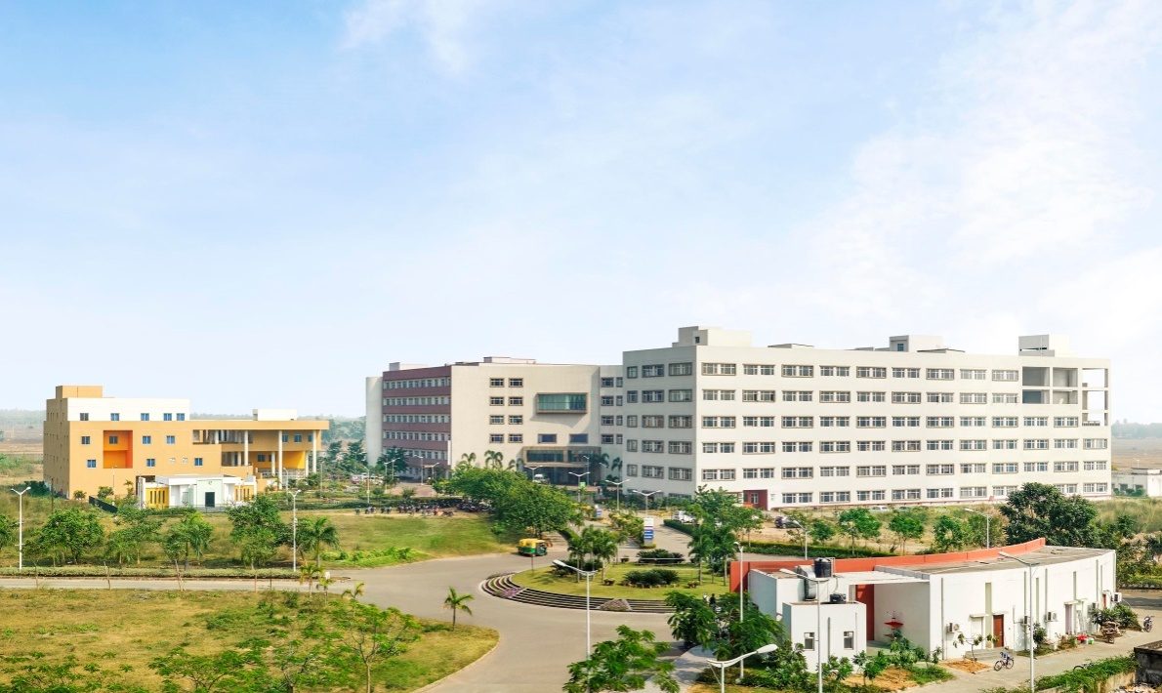
ESIC
WBHS
CGHS
Swasthya Sathi Scheme
Janakalyan Prakalpa
Academic Scheme

Slide 21
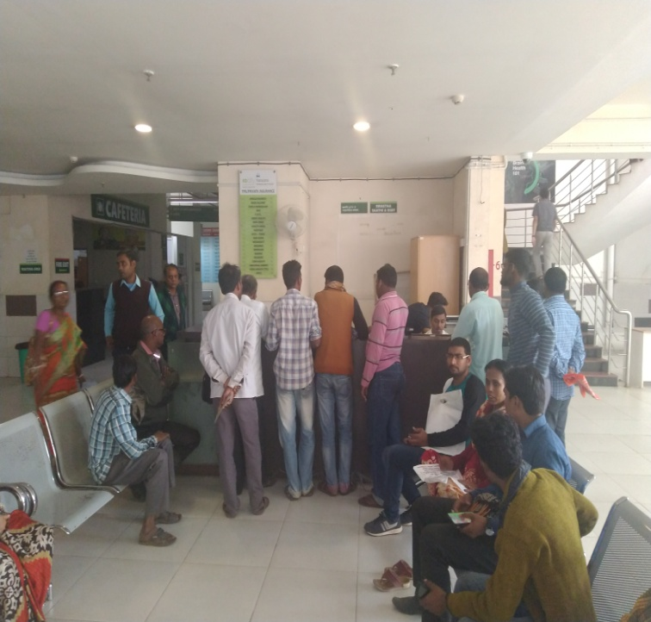
The Scheme initiated by Govt of West Bengal covers health coverage for Secondary and tertiary care up to
Rs 1.5 lakhs per annum per family through Insurance Mode and up to 5 Lakhs for certain critical diseases like, cancer, Neuro-surgery, orthopaedic and cardio logical diseases etc
Dedicated Swastha Sathi Desk in the hospital caters to huge population of the area.
Swasthya Sathi Scheme:

Slide 22
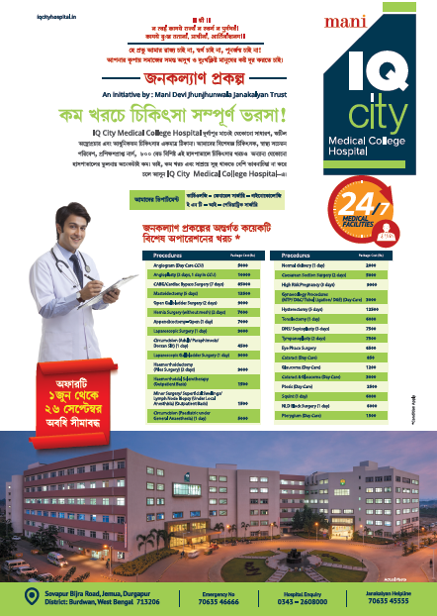

Janakalyan Prakalpa Scheme:

Slide 23
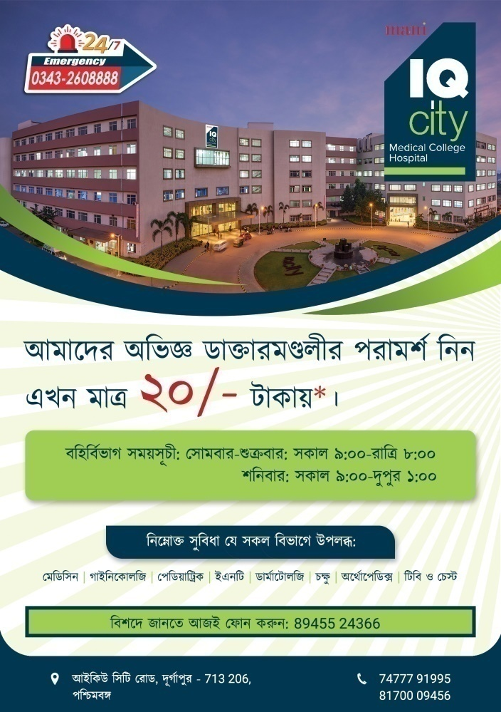
Rs. 20/- Free OPD Scheme:

Slide 24

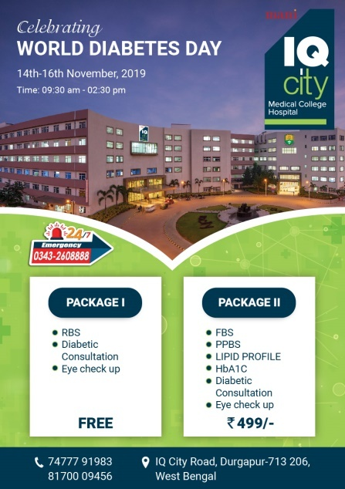
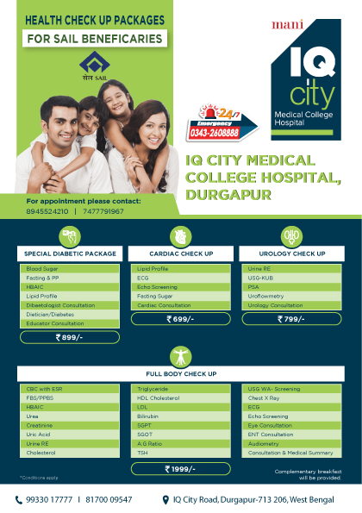

Patient friendly schemes run by the Hospital:

Slide 25
The Hospital facilitates primary and tertiary health care for all kinds of people with a provision for below poverty line (BPL) patients, which is one of the major agenda of the trust. Every day over 1000 out patients turn up to the OPD from surroundings areas.
All the departments like General Medicine, General Surgery, Orthopaedics, Obstetrics and Gynaecology, Paediatrics, Ophthalmology, Psychiatry, E.N.T., Pulmonary Medicine, Dermatology, have their OPD facilities with separate male and female examination rooms.
Out-Patient Services:

Slide 26
Out-Patient Services:
There are fixed timings for every OPD, and coordinator for each department to guide the patients.
OPD Timings: Monday to Friday: 9:00 am – 8:00 pm
Saturday: 9:00 am – 1:00 pm
(Including speciality OPD)
(Patients can call up the coordinator for detailed information on each OPD)

Slide 27
In-Patient Services:
The Inpatient wards are spaciously designed along with Duty Doctors and Nurses rooms, provided in each ward.
All patients admitted in various wards of the hospital are treated as per the hospital policy.
Diet and patient uniforms are provided to all indoor patients.
Visitors are allowed only at notified visiting hours :
Morning: 11:00 a.m. -11:30 a.m.
Evening: 4:00 p.m. – 5:00 p.m.
Staff nurses are on duty round the clock in the wards.
Admitted patients can contact the staff nurse / Floor manager for any medical assistance they need

Slide 28
IQ City medical college hospital is not a learning institution but has paved a way of success in its Public Health Initiatives dedicated towards the betterment of society at large.
Public Health Initiatives :
Under Five Clinic- We screened approx. 700 children under the age of 5 years for prematurity, IUGR , Immunization , Growth and Nutrition.
School Health Camps- We organized weekly camp to assess Mental and Physical development and proper implementation of Health and Hygiene along with Dental Care. We distributed approx. 5000 Hand Rub / Hand Sanitizer to the kids.
Women Health And Hygiene –We distributed nearly 1000 of Sanitary Napkins in rural areas to inculcate the habit of using some hygienic product during their periods. We plan to train women with the collaboration of one NGO in villages or in a cluster of villages periodically so that they shall be the contact point to provide these Sanitary Napkins
.

Slide 29
Health awareness program- We often conduct Health Awareness Programs in our institute and also in the Rural and Urban health centers to create an awareness regarding Hypertension ,Diabetes, Blood Donation, Obesity, Drug Abuse , Smoking etc.
National Health Programme on Vector borne diseases, Tuberculosis control, Leprosy control, District blindness control, Non communicable diseases are carried on in the hospital . Our Medical unit go for field visit and screened patients based on the guidelines and follow the protocol related to National Health Programme .
Operation Smile –We are one of the few hospital in eastern India , where monthly approx. 100 children with cleft lips and palate get the benefit of plastic/ reconstructive surgery by the national and international trained specialist .
General Medical Camp- We conducted nearly 50 -60 medical camp every month in nearby villages for routine Health checkup and screening . We also provide them the free specialist consultation and Medicines.

Slide 30
.
Ante Natal Services & Postnatal Care- Estimated 300 mothers monthly are counseled for awareness , clinical assessment , advice and treatment.
Family Planning- We educate approx. 1000 families regarding completion of families and use of proper contraceptives.
Mobile Health Clinic - Nearly 15000 patients were screened and treated by this service
Blood Donation Camp- Blood donation camps are conducted regularly by the institute throughout the year .
JANAKALYAN Scheme – It offers different Operation Packages( Gen. Surgery , Pediatric Surgery ,Cardiology ,Gynecology ,ENT,EYE) in a minimum charges to serve the mass .

Slide 31
Minor Surgical Procedures- Around 400 patients in the rural areas were benefited by this initiatives where we performed minor surgical procedure in our Rural Clinic.
Laboratory Services- 1300 laboratory services were given which included Routine Urine ,Stool and Blood Test for the rural population and 50% discount for any kind of investigations during Night( 11pm-5am) for all.
Free refreshment corner – Dadiji Ki Chai is a free service for all in the campus.
Free Transportation – Approx 1000 families were used the service to reach Hospital and pickup –drop facility for bed ridden patients.

Slide 32
PHOTO GALLERY

Slide 33
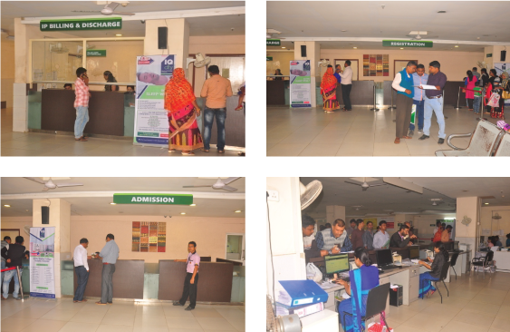
Admission & Discharge Desk:

Slide 34
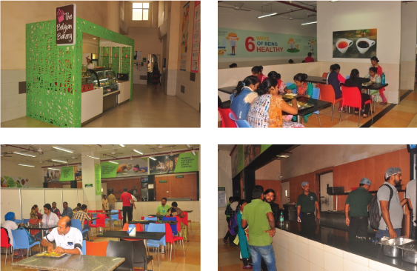
Bakery & Cafeteria:

Slide 35
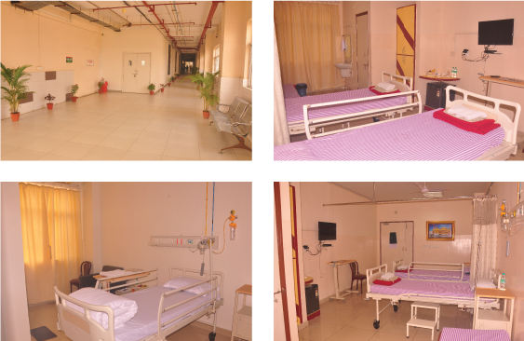
Deluxe Ward:

Slide 36
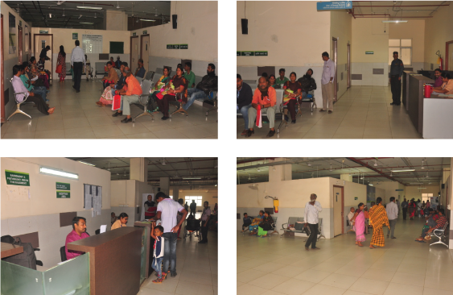
OPD Area:

Slide 37
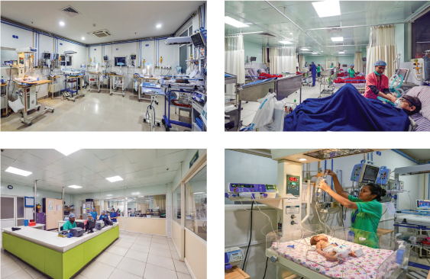
Critical Care Unit:

Slide 38
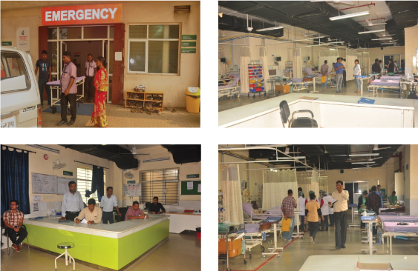
Emergency Department:

Slide 39
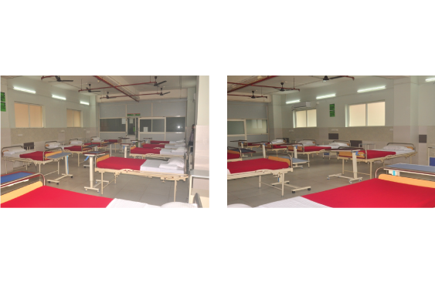
Dormitory:

Slide 40
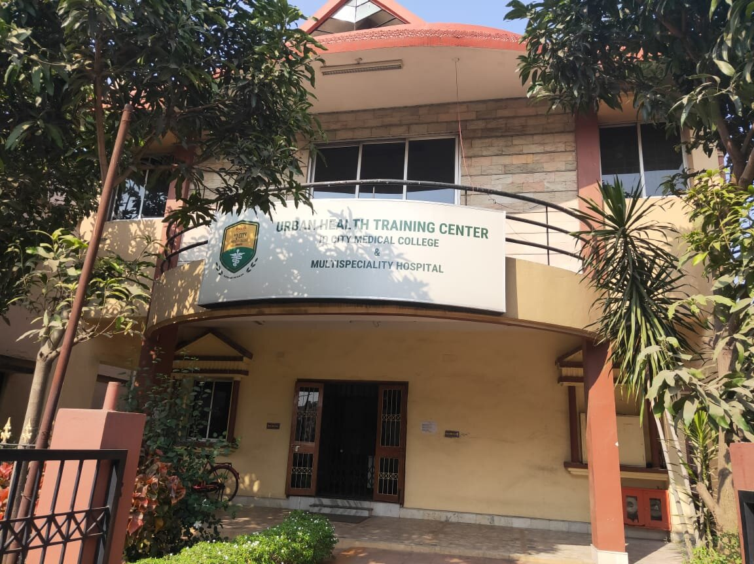
Urban Health Training Centre (UHTC):

Slide 41
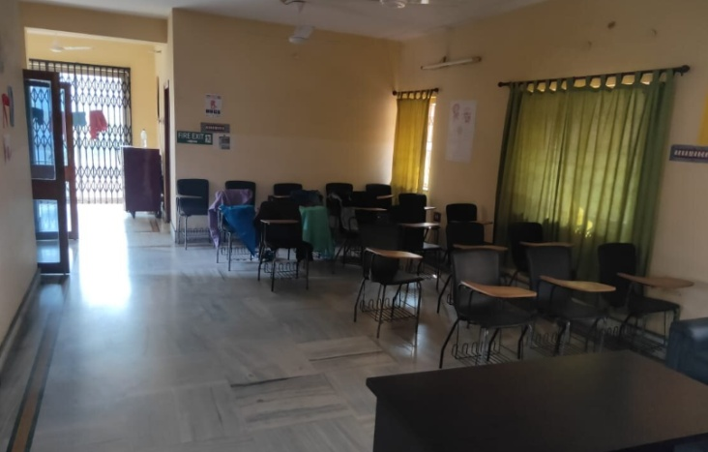
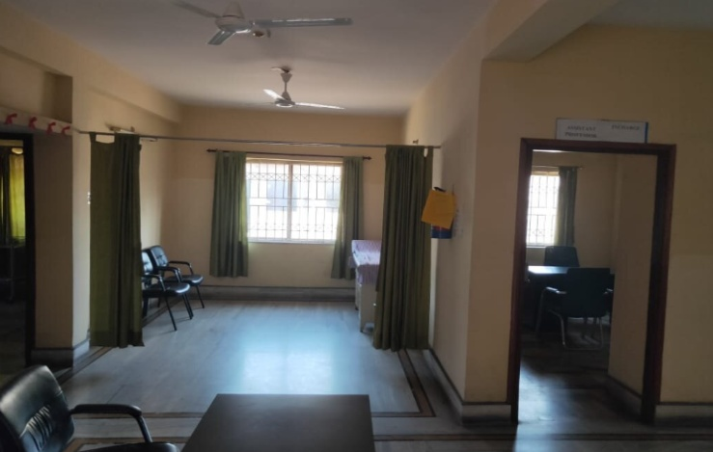
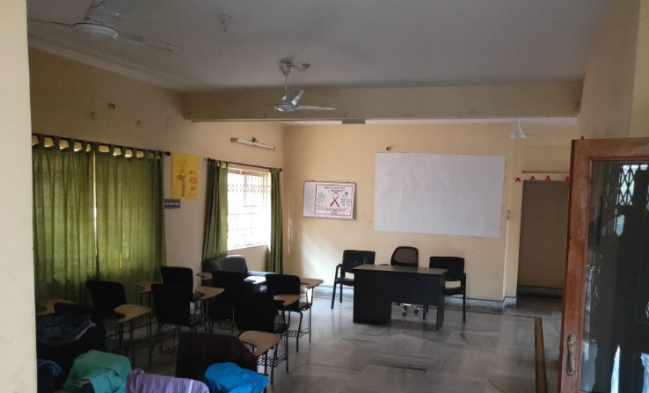
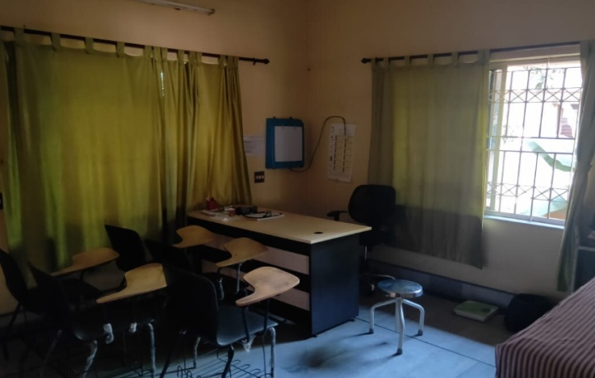
Urban Health Training Centre (UHTC):

Slide 42
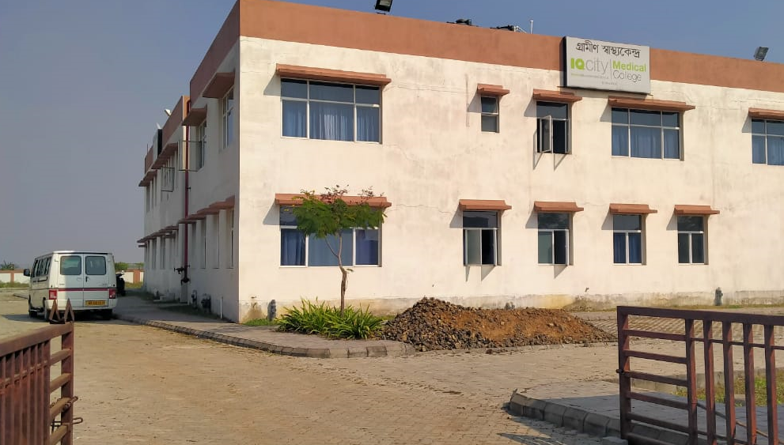
Rural Health Training Centre (RHTC):

Slide 43
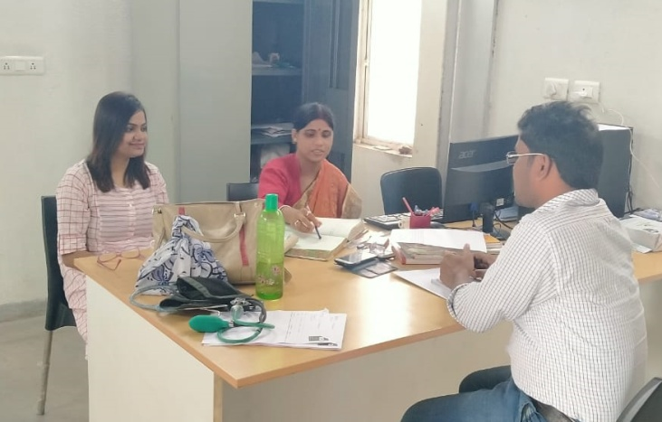
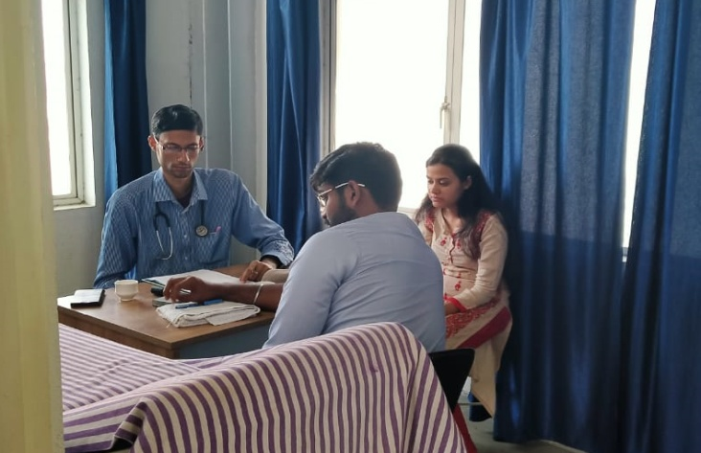
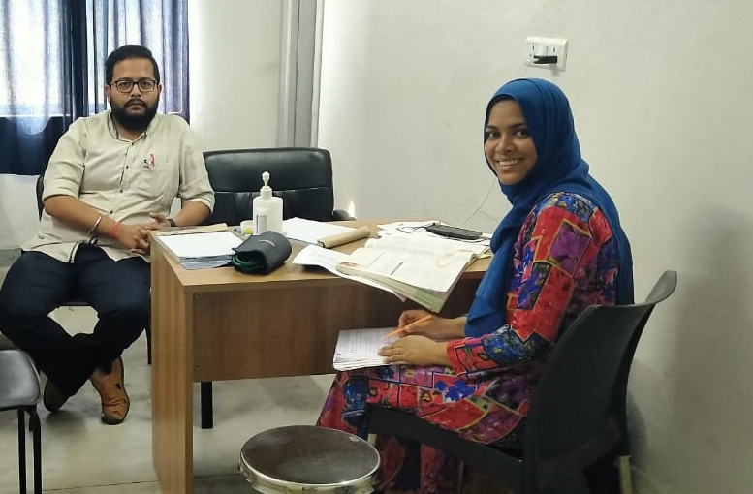
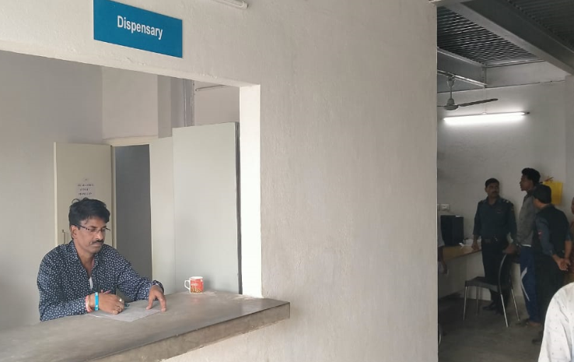
Rural Health Training Centre (RHTC):

Slide 44


Slide 45




