Slide 1


IQ City Medical
College Hospital, Durgapur

Slide 2
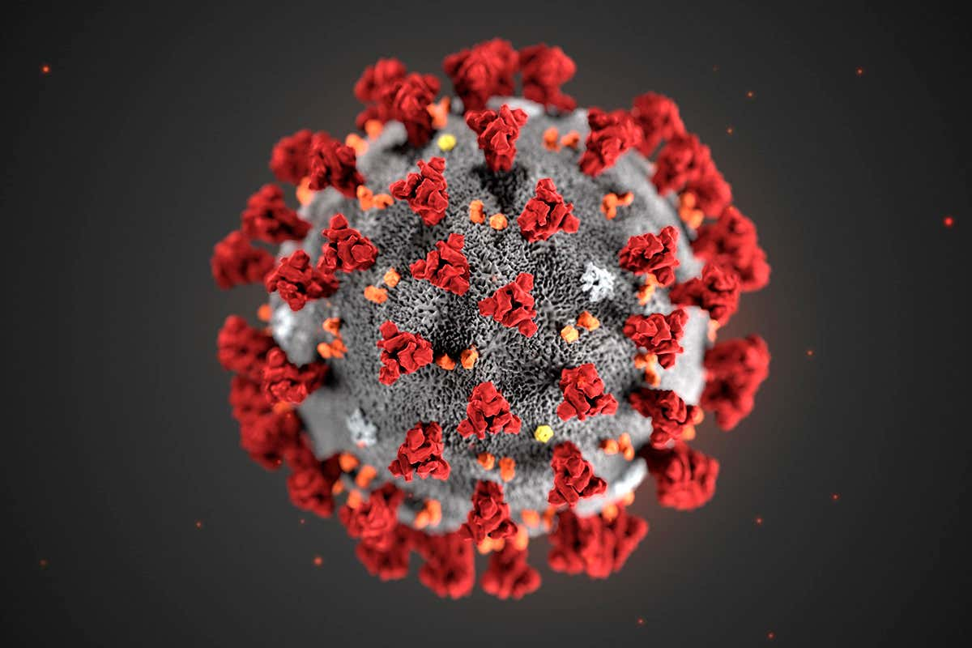
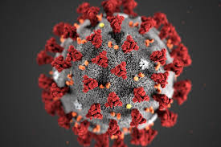
COVID 19

Slide 3
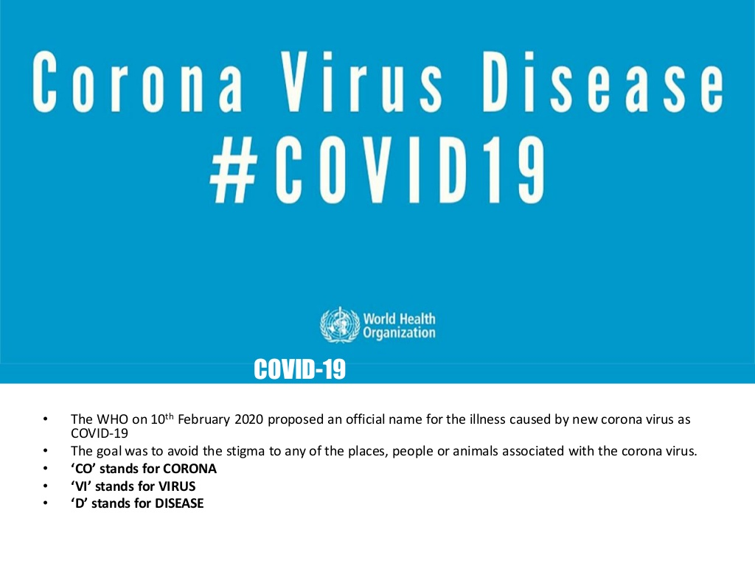

Slide 4
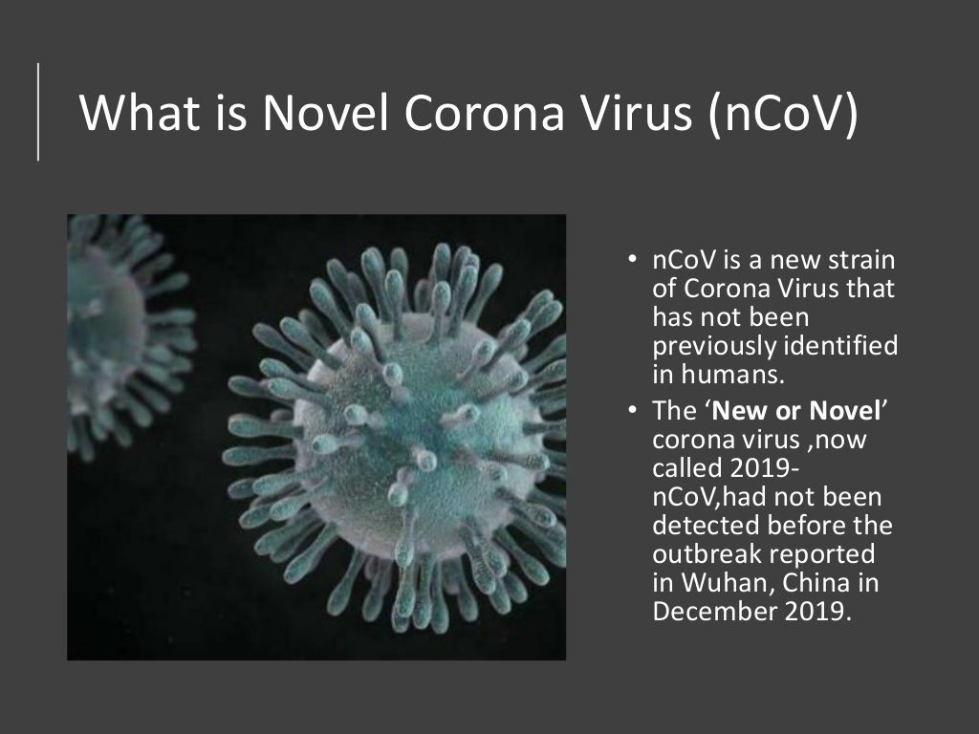

Slide 5
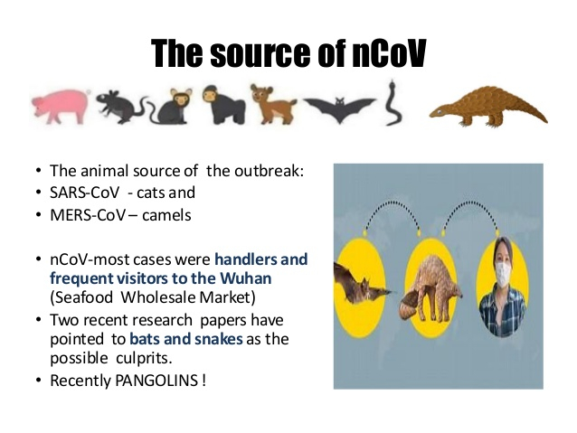

Slide 6
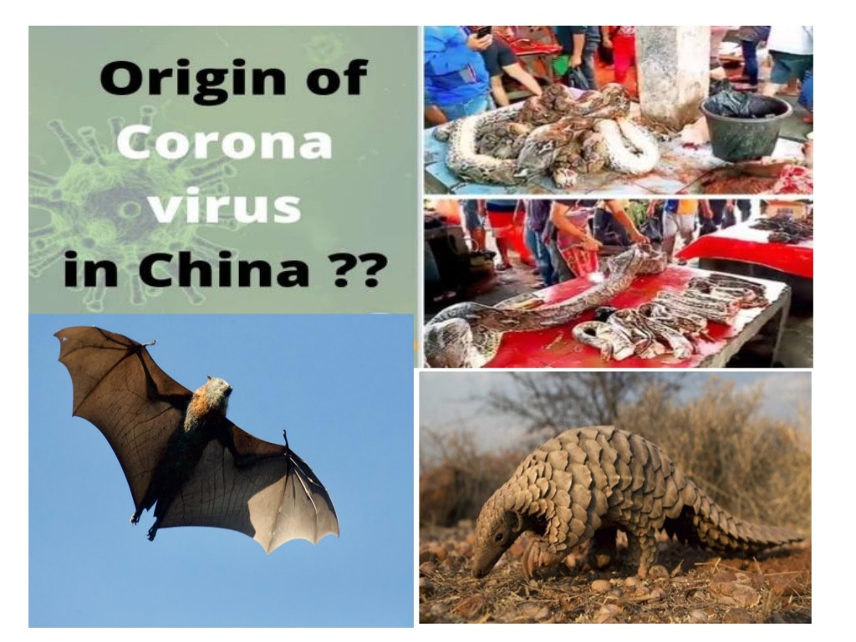

Slide 7
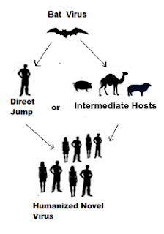

Slide 8
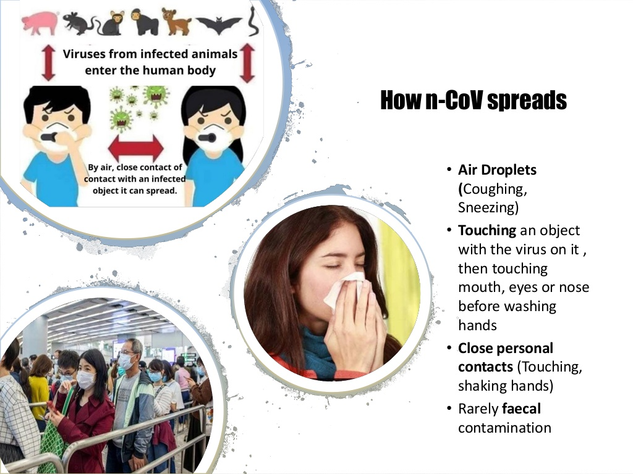

Slide 9

EPIDEMIOLOGY

Slide 10
First reported from Wuhan, China on December 31, 2019.
COVID-19 is the infectious disease caused by the most recently discovered coronavirus. This new virus and disease were unknown before the outbreak began in the Wuhan, China.
According to WHO report, there has been 1,25,288 confirmed cases, 4614 deaths worldwide involving 118 countries, as of March 12, 2020.
China alone holds the record of 80,924 confirmed cases and 4,984 deaths, this is followed by Italy having 12,462 confirmed cases, 1016 deaths, followed by Iran.

Slide 11
WHO has been assessing this outbreak around the clock & is deeply concerned by the alarming levels of spread, severity & inaction of the Govt. of several countries.
WHO has therefore declared COVID 19 to be characterised as PANDEMIC.

Slide 12
Country | No. of confirmed cases | No. of deaths
CHINA | 80,924 | 4984
ITALY | 12,462 | 1016
IRAN | 9000 | 366
REPUBLIC OF KOREA | 7983 | 237
INDIA | 74 | 1
GLOBALLY | 1,25,288 | 4614

Slide 13
Graph: no. of confirmed cases & deaths v/s time period (globally)

Slide 14
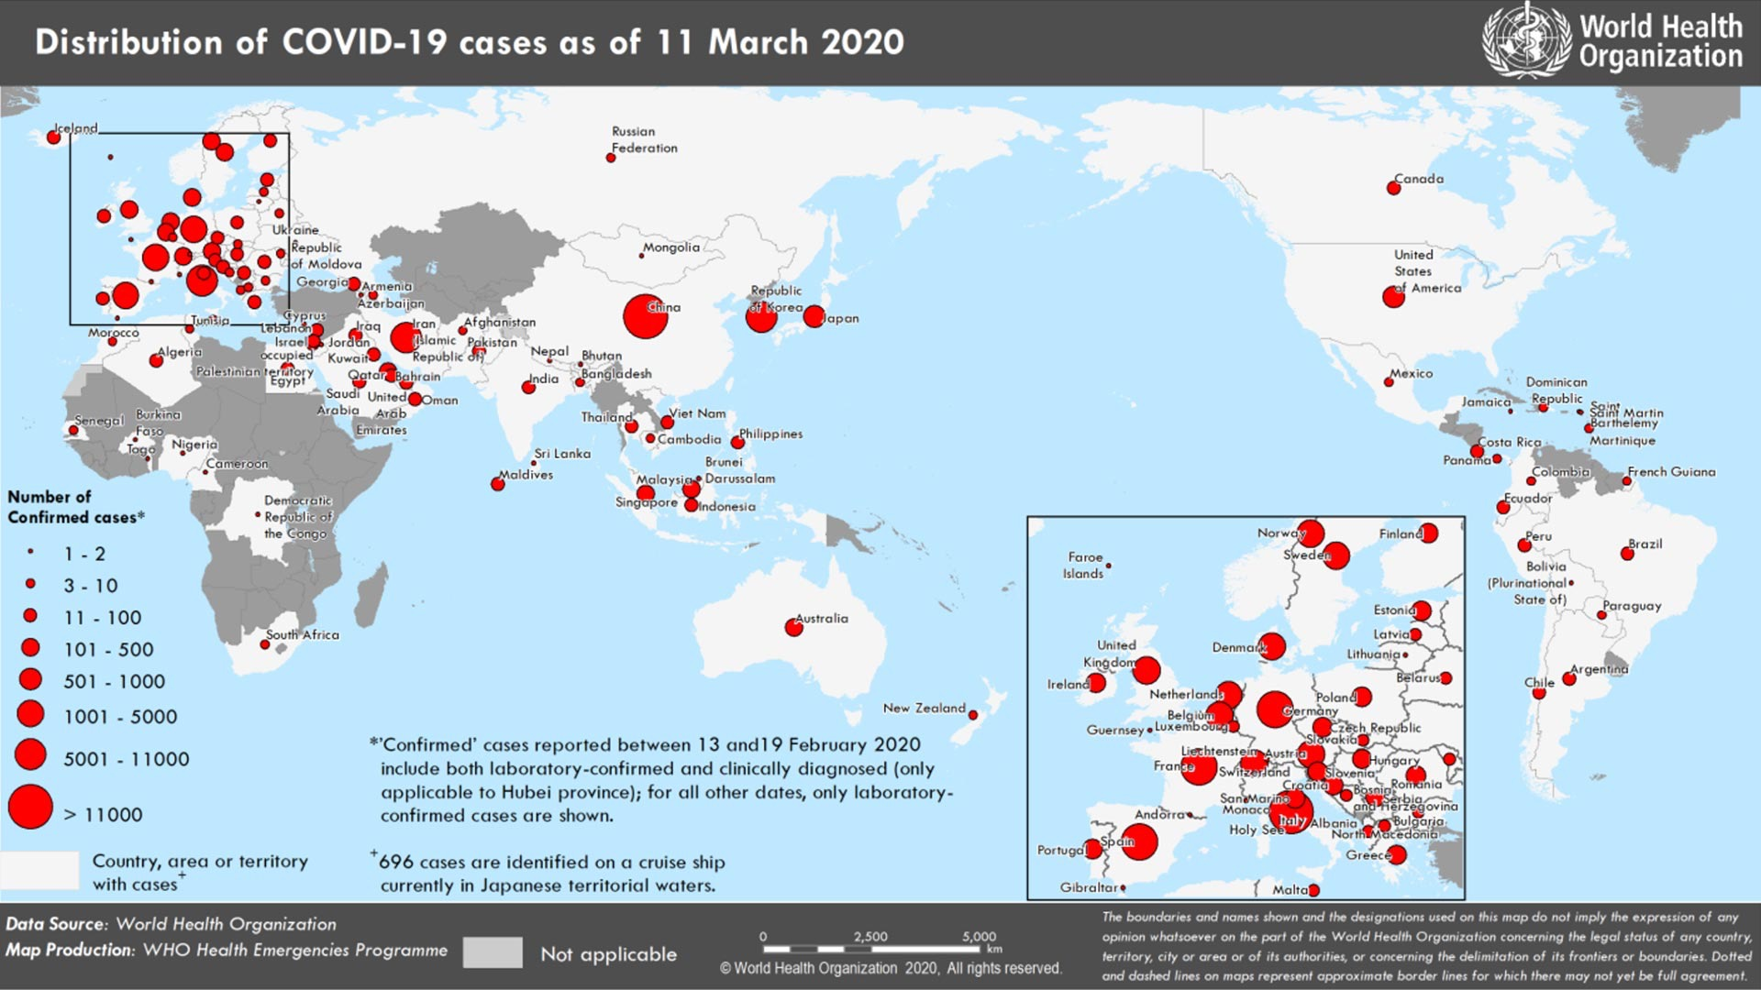

Slide 15
SITUATION REPORT- INDIA
On January 30 2020, a laboratory confirmed case of 2019-nCoV was reported on Kerala. The patient, a student returning from Wuhan is now fully recovered.
Between January 30 and February 03 2020, MoHFW confirmed 3 cases of nCoV-19 in Kerala. As of February 20 2020, all the 3 cases have fully recovered and discharged from the hospital.

Slide 16
CURRENT SITUATION REPORT IN INDIA
According to WHO as of March 12, 74 confirmed cases have been reported in India from states including- Delhi(4), Haryana(14), Uttar Pradesh(9), Ladakh(2), Jammu(1), Rajasthan(2), Telangana(1), Kerala(9), Karnataka . Of these 16 are foreign nationals.
As of March 12 India has recorded its First death in Karnataka. The 76 Yr old man had returned from Saudi Arabia on Feb 29.
Hospital isolation of the cases, tracing and home quarantine of their contacts is ongoing, in the states from where the cases have been reported.
All the states are on high alert, for early detection and containment of any further cases.
The Prime Minister’s Office, MoHFW and cabinet Secretary are closely monitoring the situation of COVID-19.

Slide 17
graph: no. of confirmed cases and deaths v/s time period(india)

Slide 18
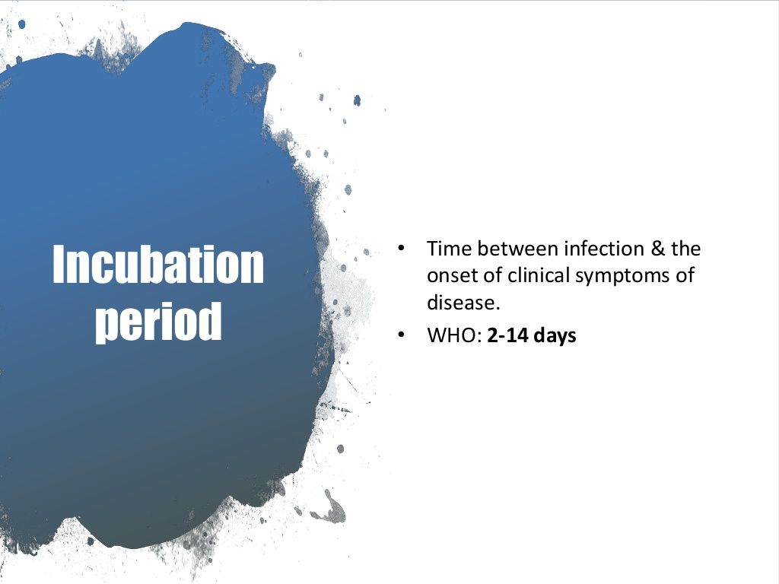

Slide 19
What to expect if you are screened?
According to several representatives at the airports that are screening passengers, the screening process is handled in a separate room, usually in customs facility.
The CDC is checking temperature of travelers through a handheld thermometer that requires no contact with skin.
Travelers are also asked to fill out a short questionnaire that lists their travel history as well as if they have any symptoms of an illness and their contact information.
Along with a fever, the screeners will be looking for people who have cough or are having troubled breathing.
If you are sick you will be evaluated further.
CDC Officials will determine if hospitalization is necessary and whether or not you need further care.
If you aren't ill, you will be given a card that has important information about corona virus and the steps you should take if you begin to feel ill.

Slide 20
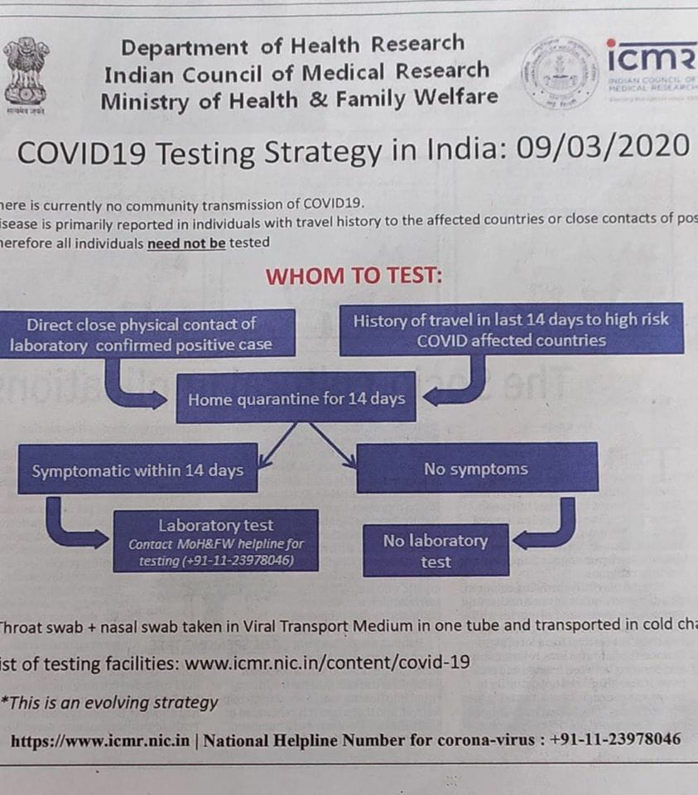

Slide 21
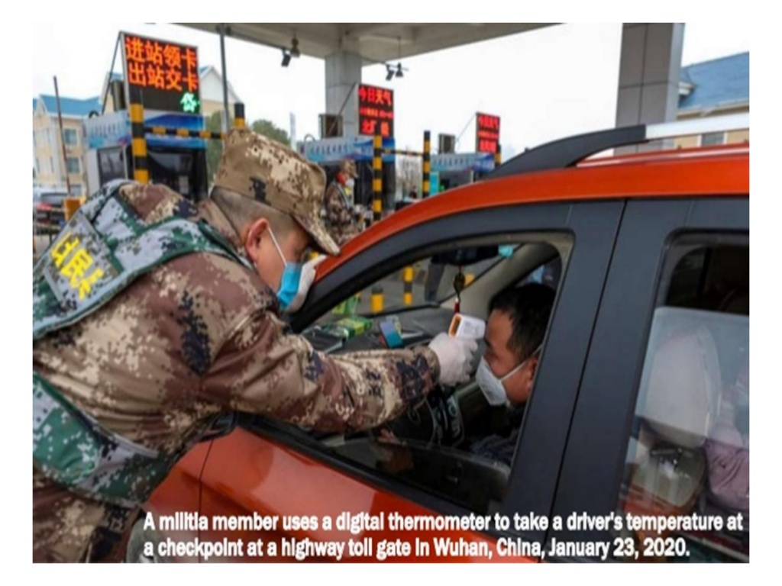

Slide 22
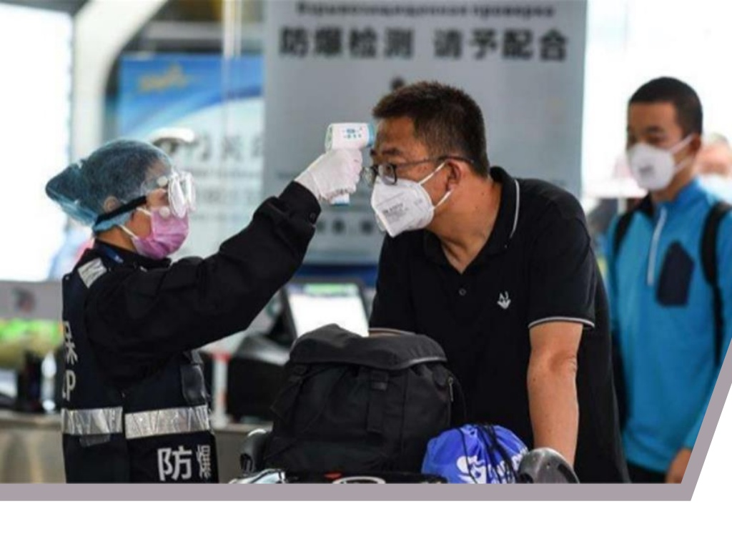

Slide 23


Slide 24
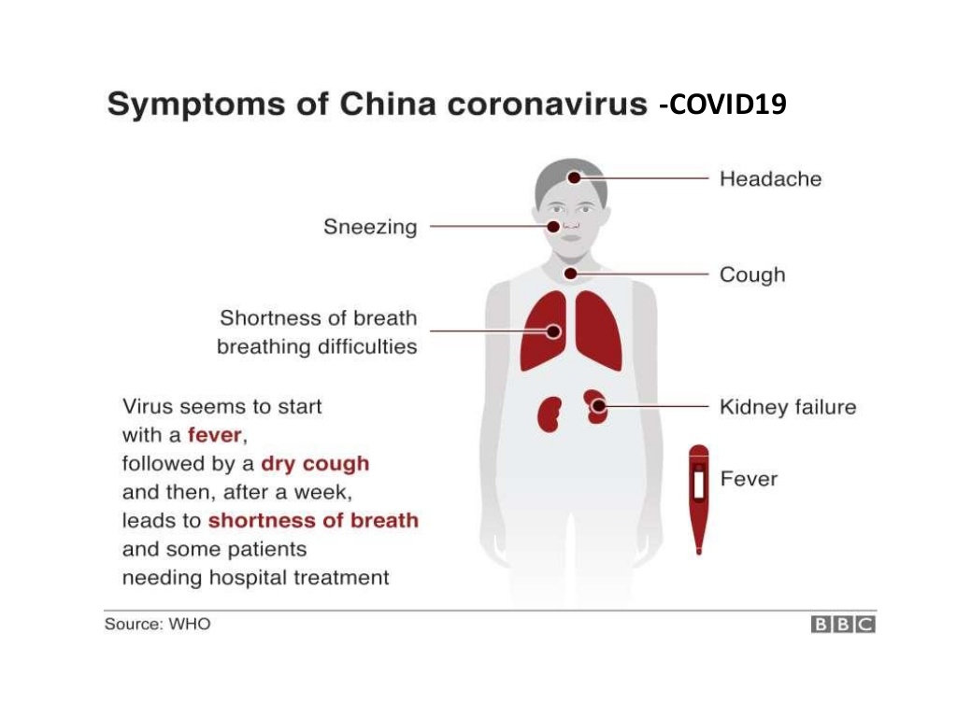

Slide 25
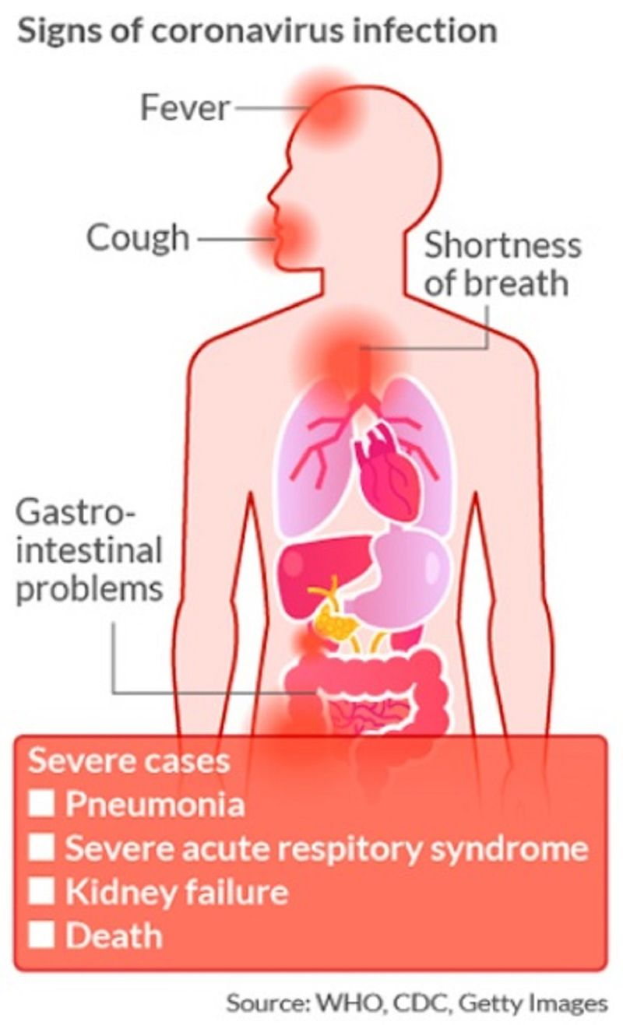

Slide 26


Slide 27
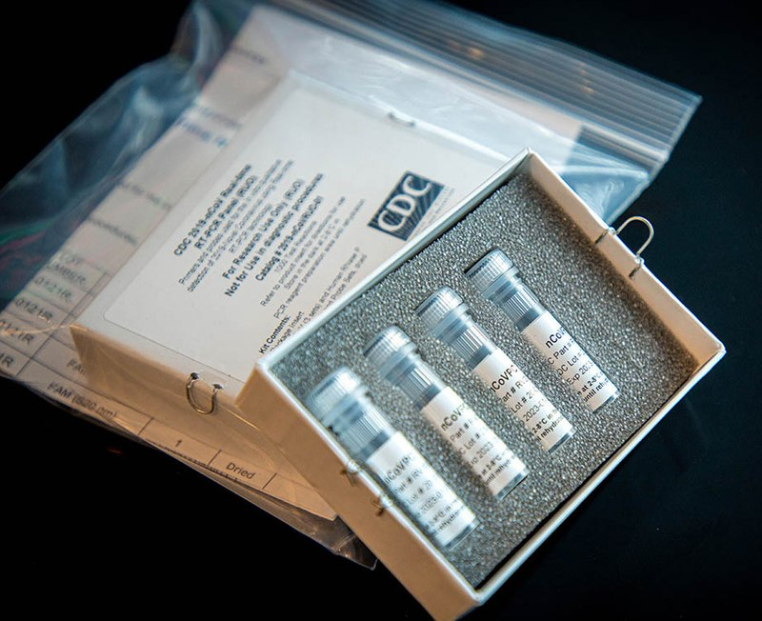
The WHO has published several testing protocols for the disease. The standard method of testing is real time reverse transcription polymerase chain reaction (rRT-PCR).

Slide 28
The test can be done on respiratory samples obtained by various methods, including
nasopharyngeal swab or sputum sample.
Results are generally available within a few hours to 2 days.
Blood tests can be used, but these require two blood samples taken two weeks apart and the results have little immediate value.

Slide 29
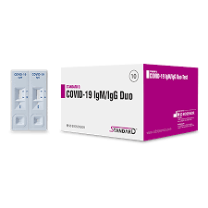
COVID-19 testing can also be done with Rapid antibody test kits.
Antibody assays use a
blood serum sample and
can provide a positive result
even if the person has
recovered and the virus is
no longer present.
Specificity is 95%

Slide 30


Slide 31


Slide 32
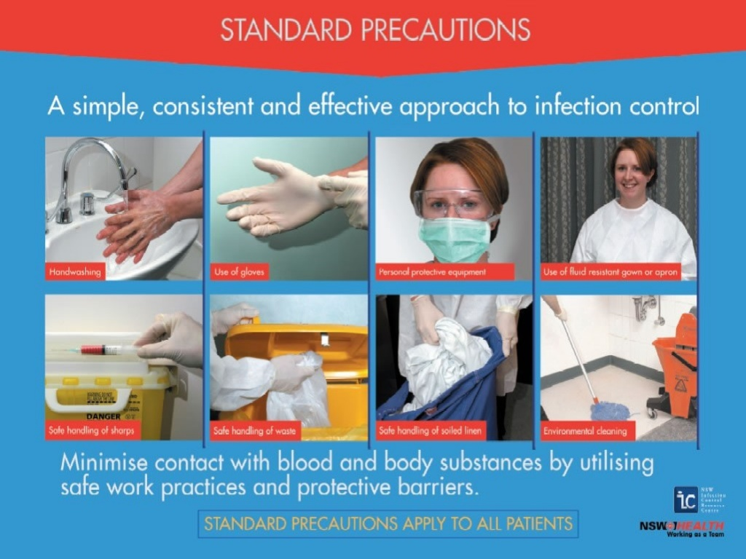

Slide 33


Slide 34
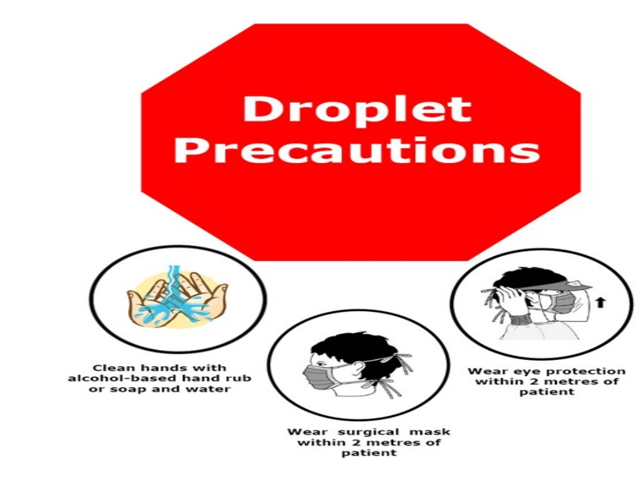

Slide 35
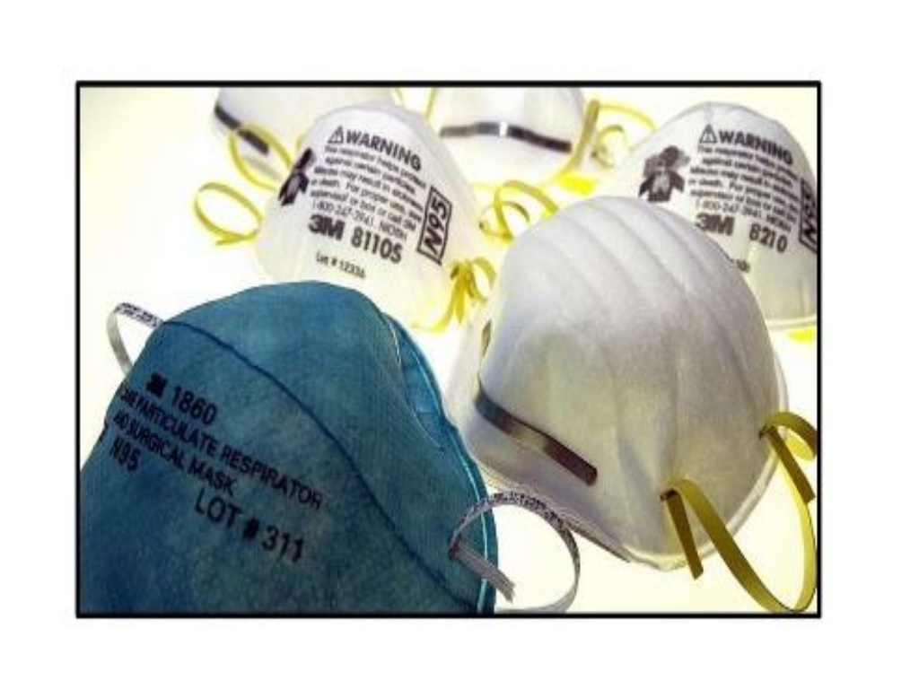

Slide 36
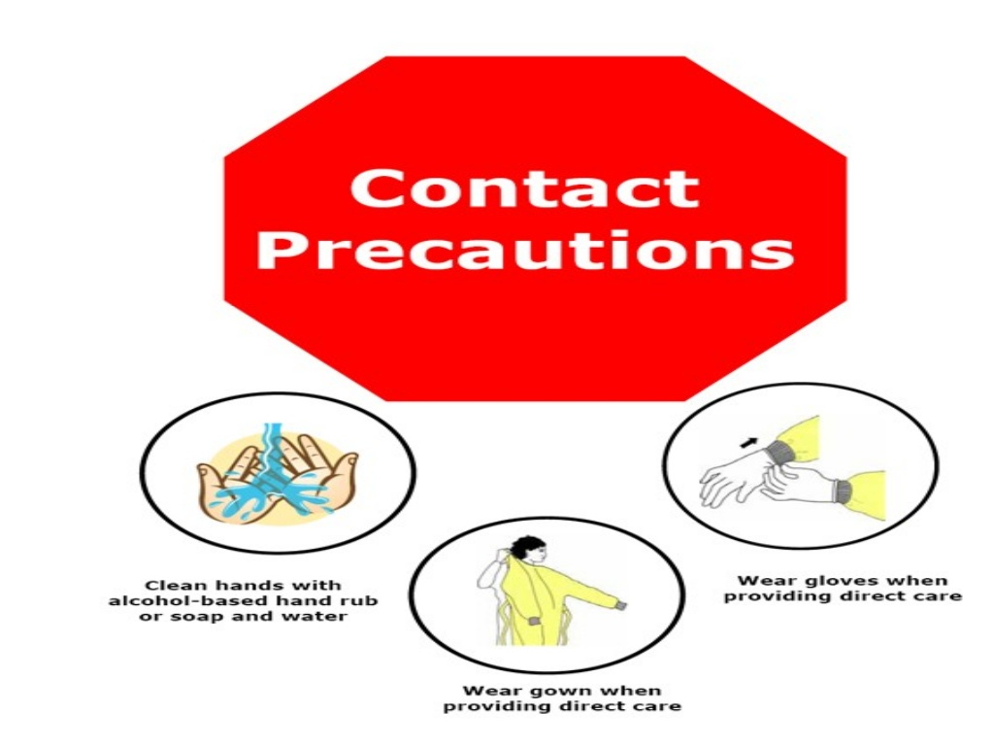

Slide 37
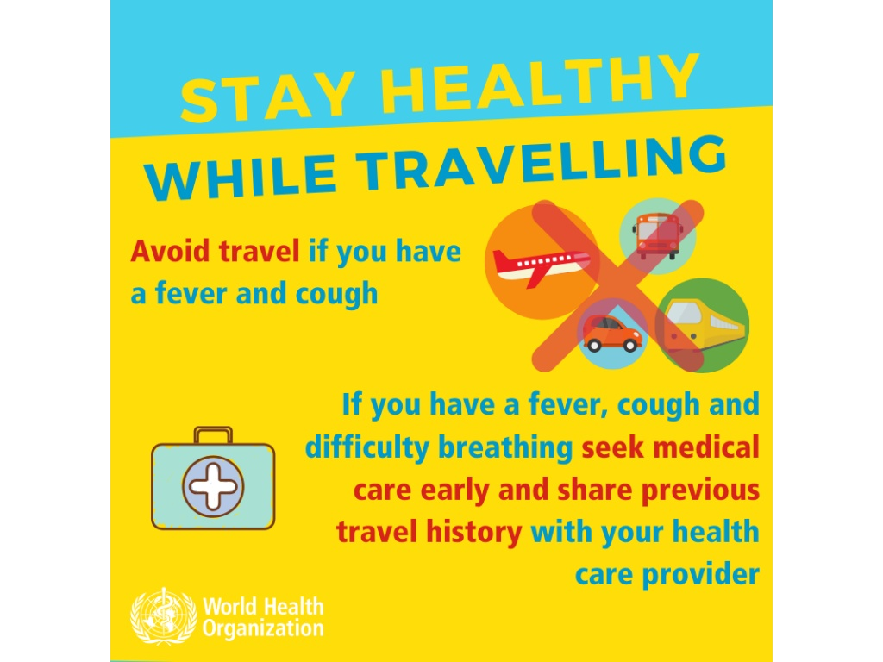

Slide 38
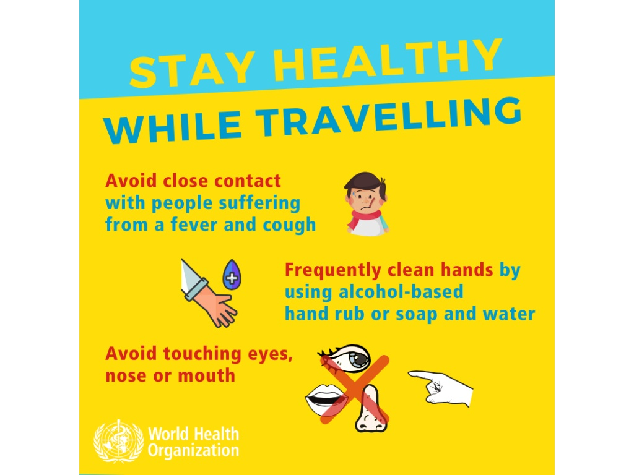

Slide 39
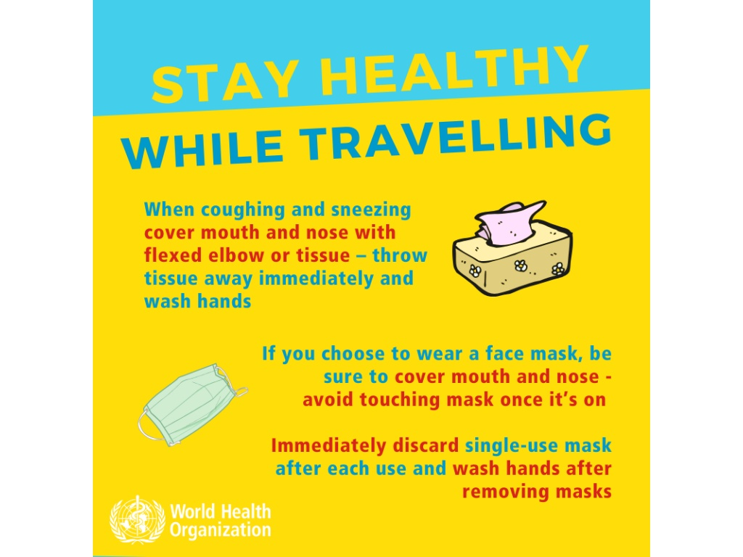

Slide 40


Slide 41
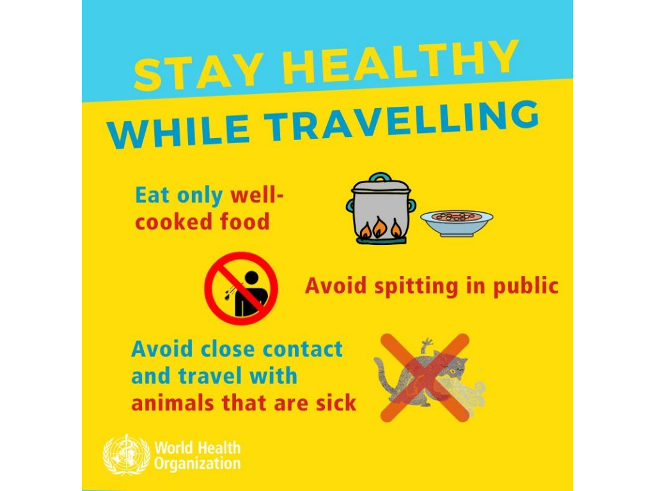

Slide 42
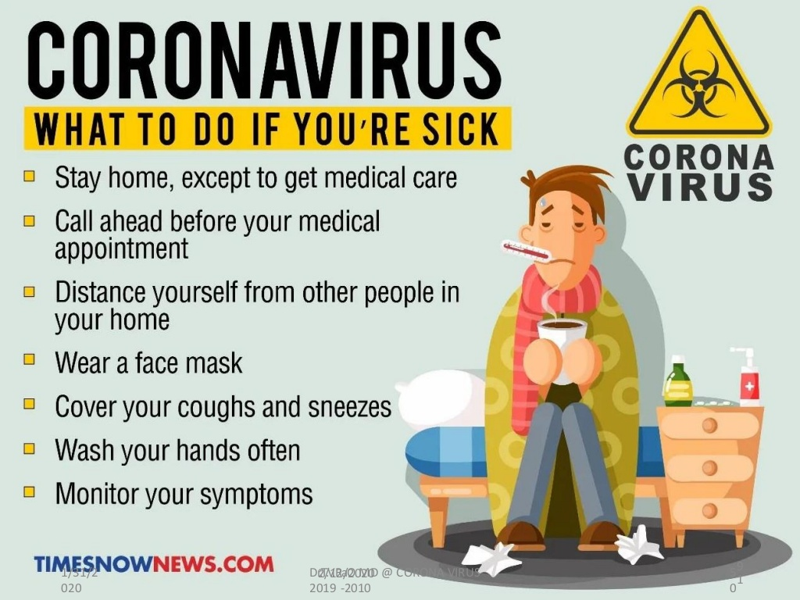

Slide 43
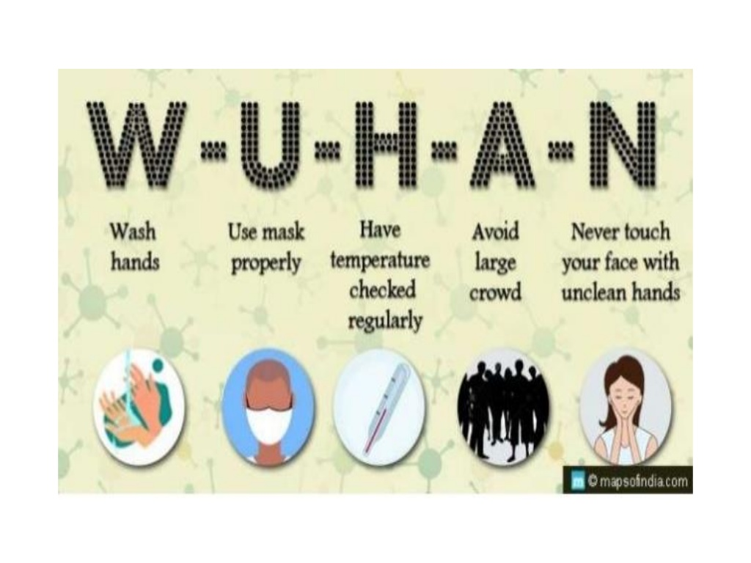

Slide 44
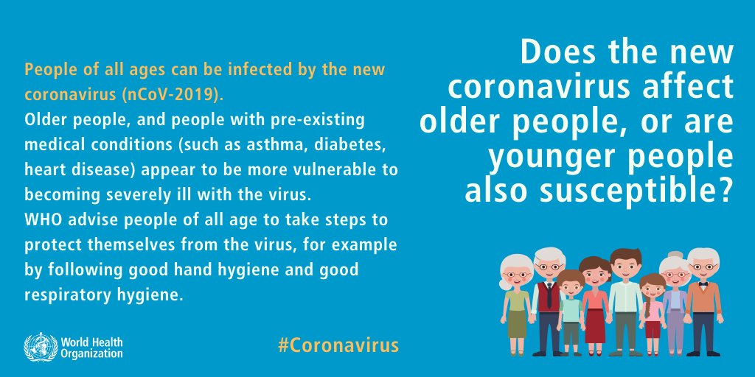

Slide 45
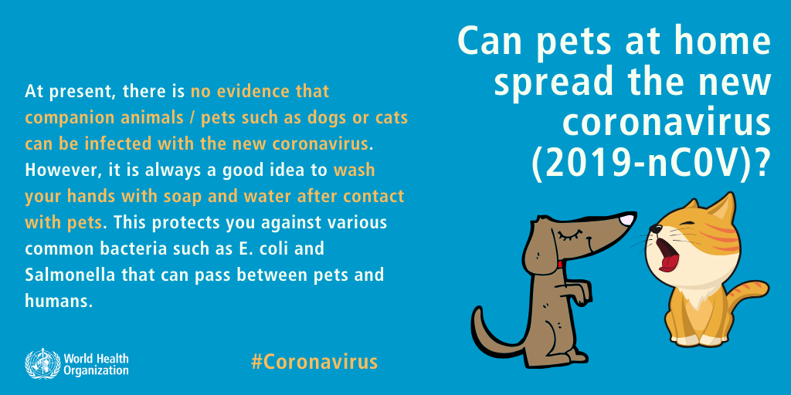

Slide 46
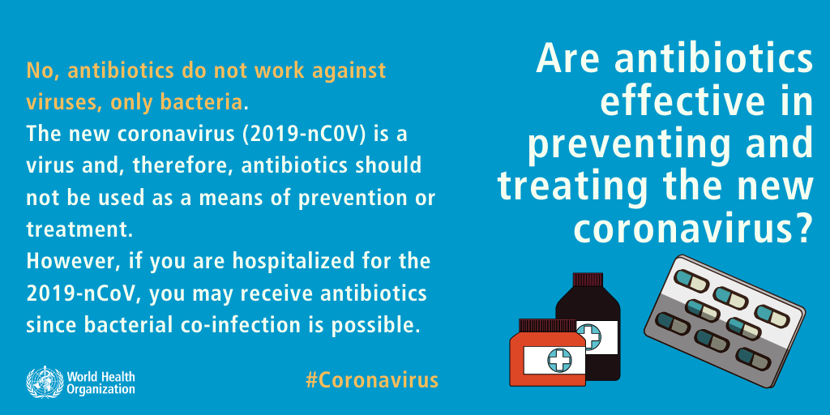

Slide 47
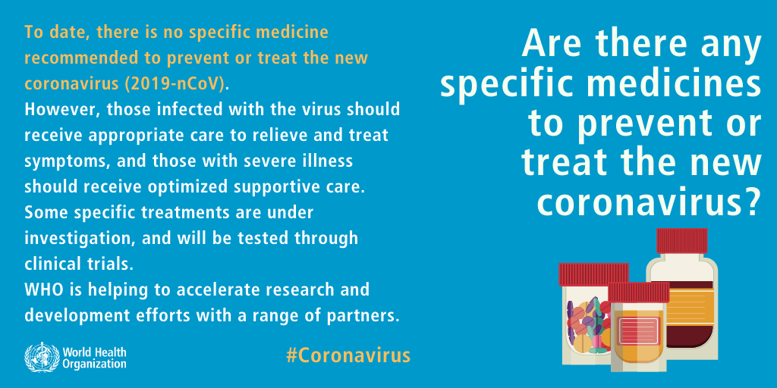

Slide 48
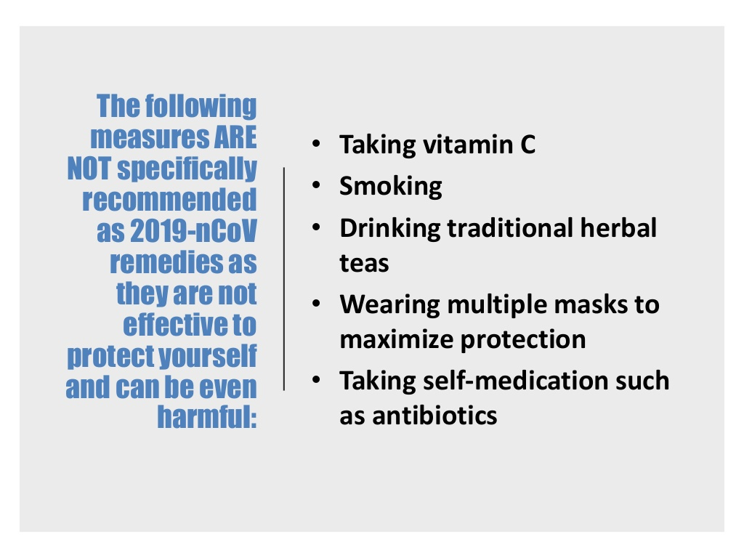

Slide 49

MANAGEMENT

Slide 50
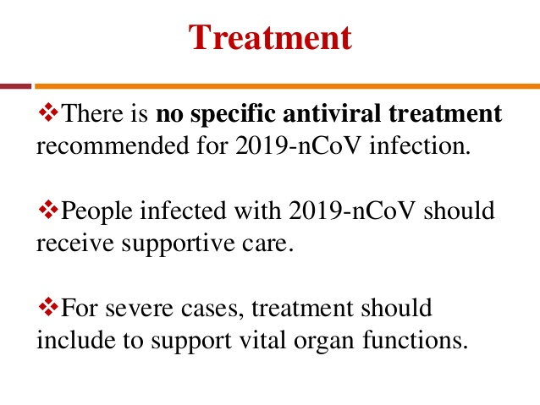

Slide 51
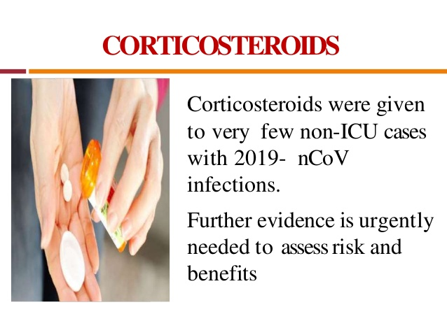

Slide 52
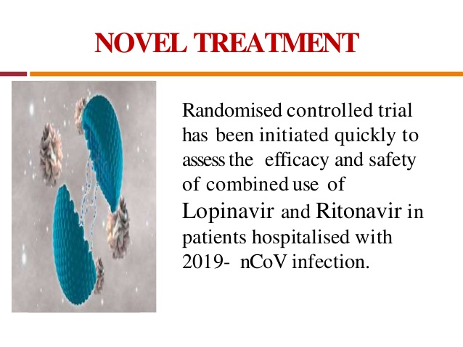

Slide 53
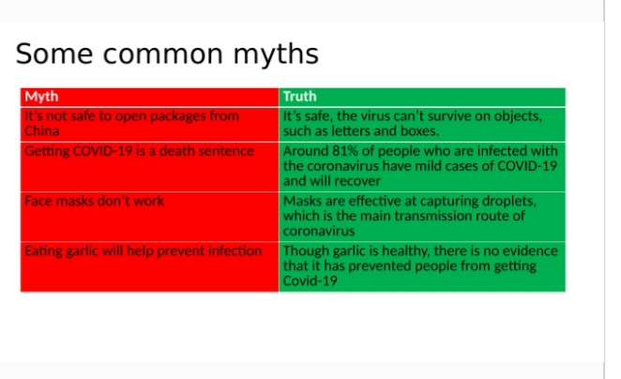

Slide 54


Slide 55
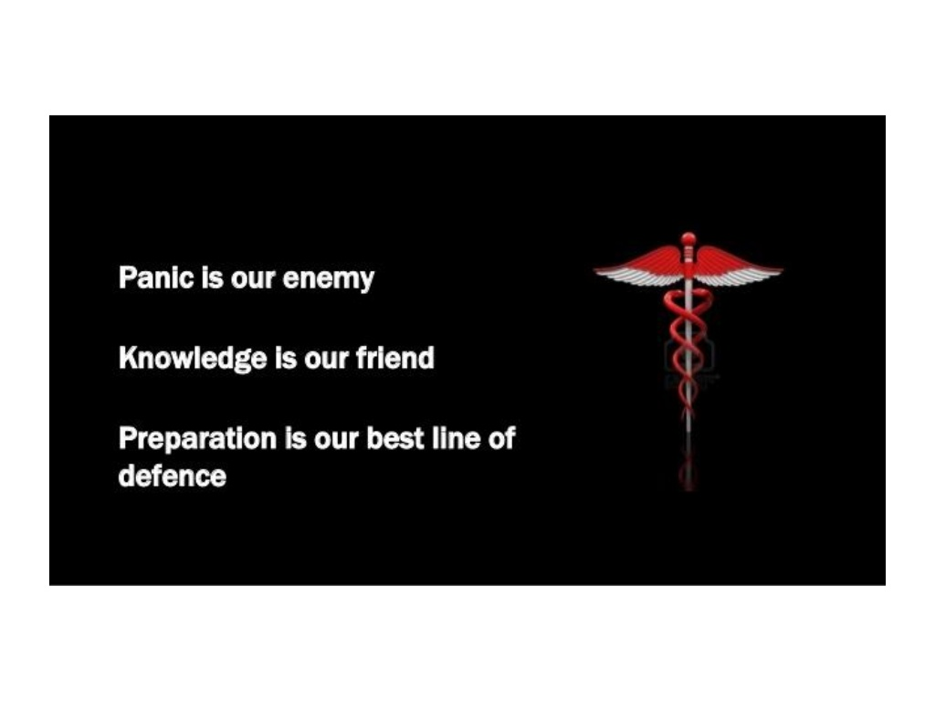

Slide 56
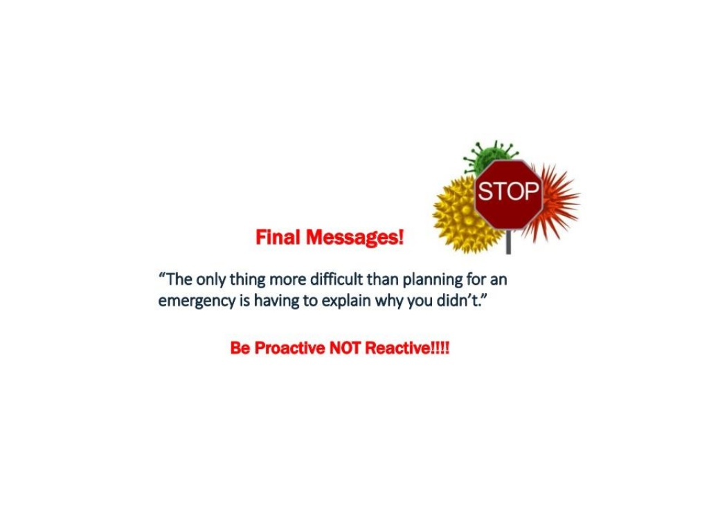

Slide 57


